Slide 1
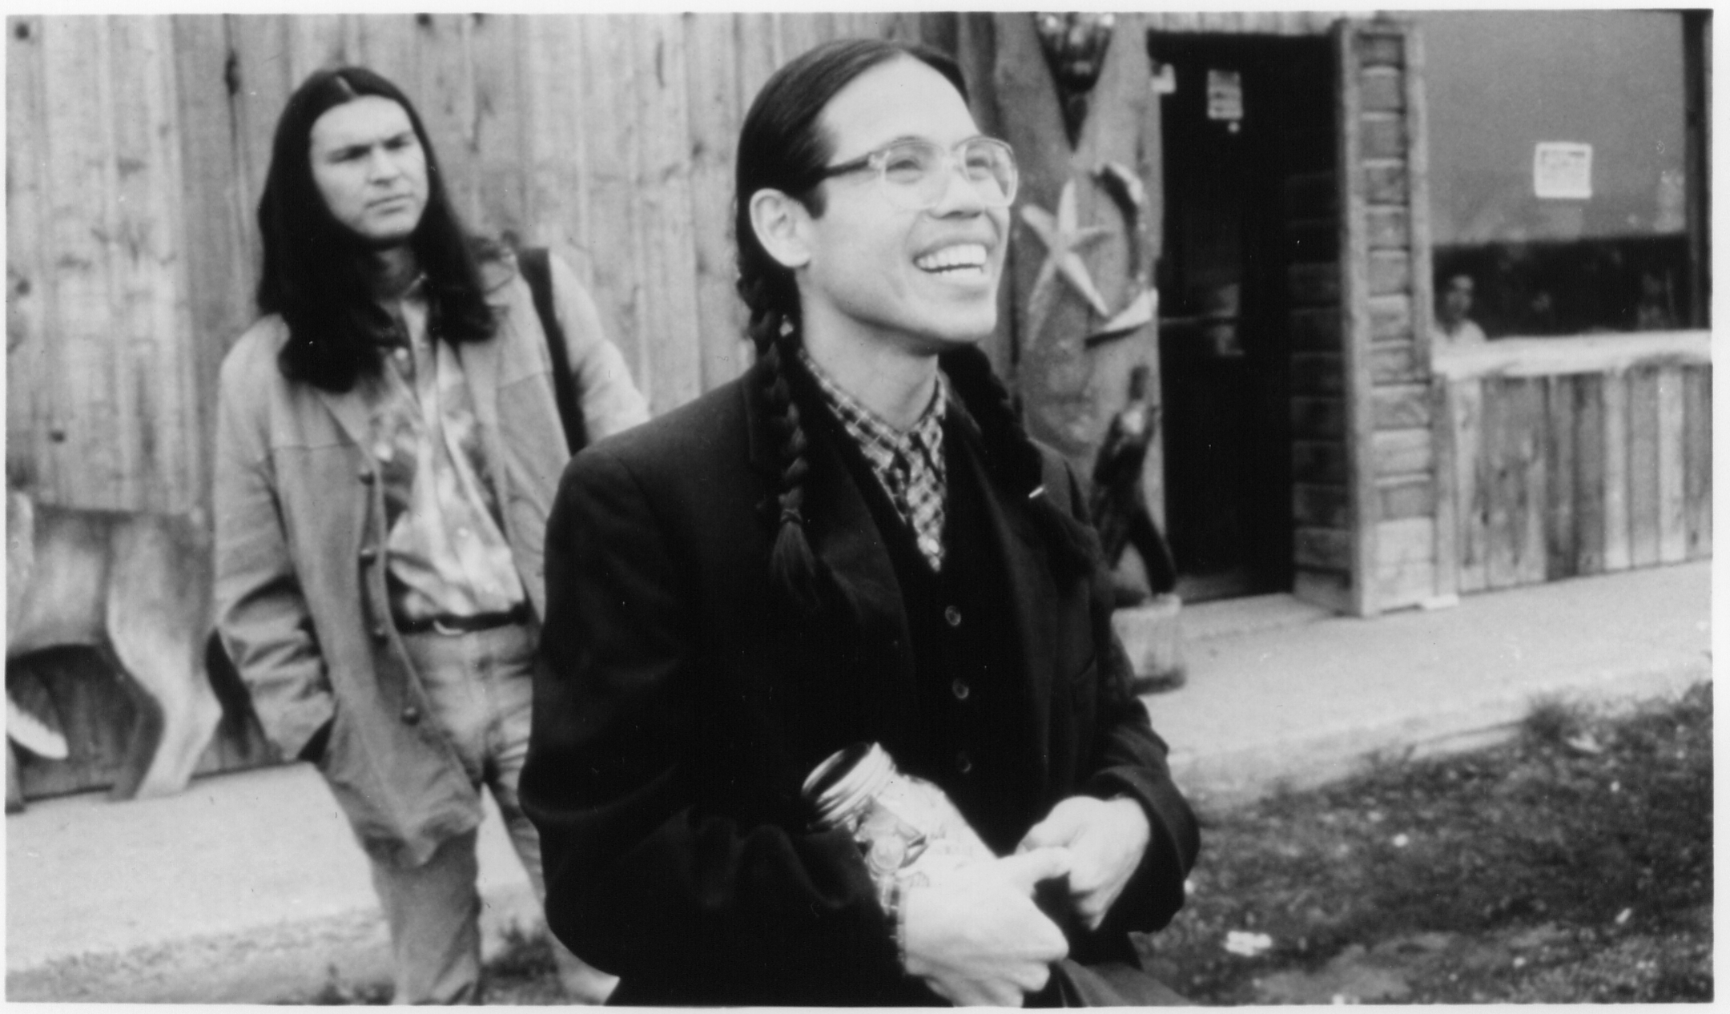

Slide 2

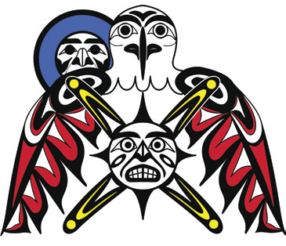


Tripartite Efforts Have Led to Better Outcomes for British Columbia’s First Nations
Evan Adams, MD, MPH
2010 Joint Tribal Emergency Preparedness Conference
Thursday, September 30th, 2010
Notes:
05/10/2010
2

Slide 3
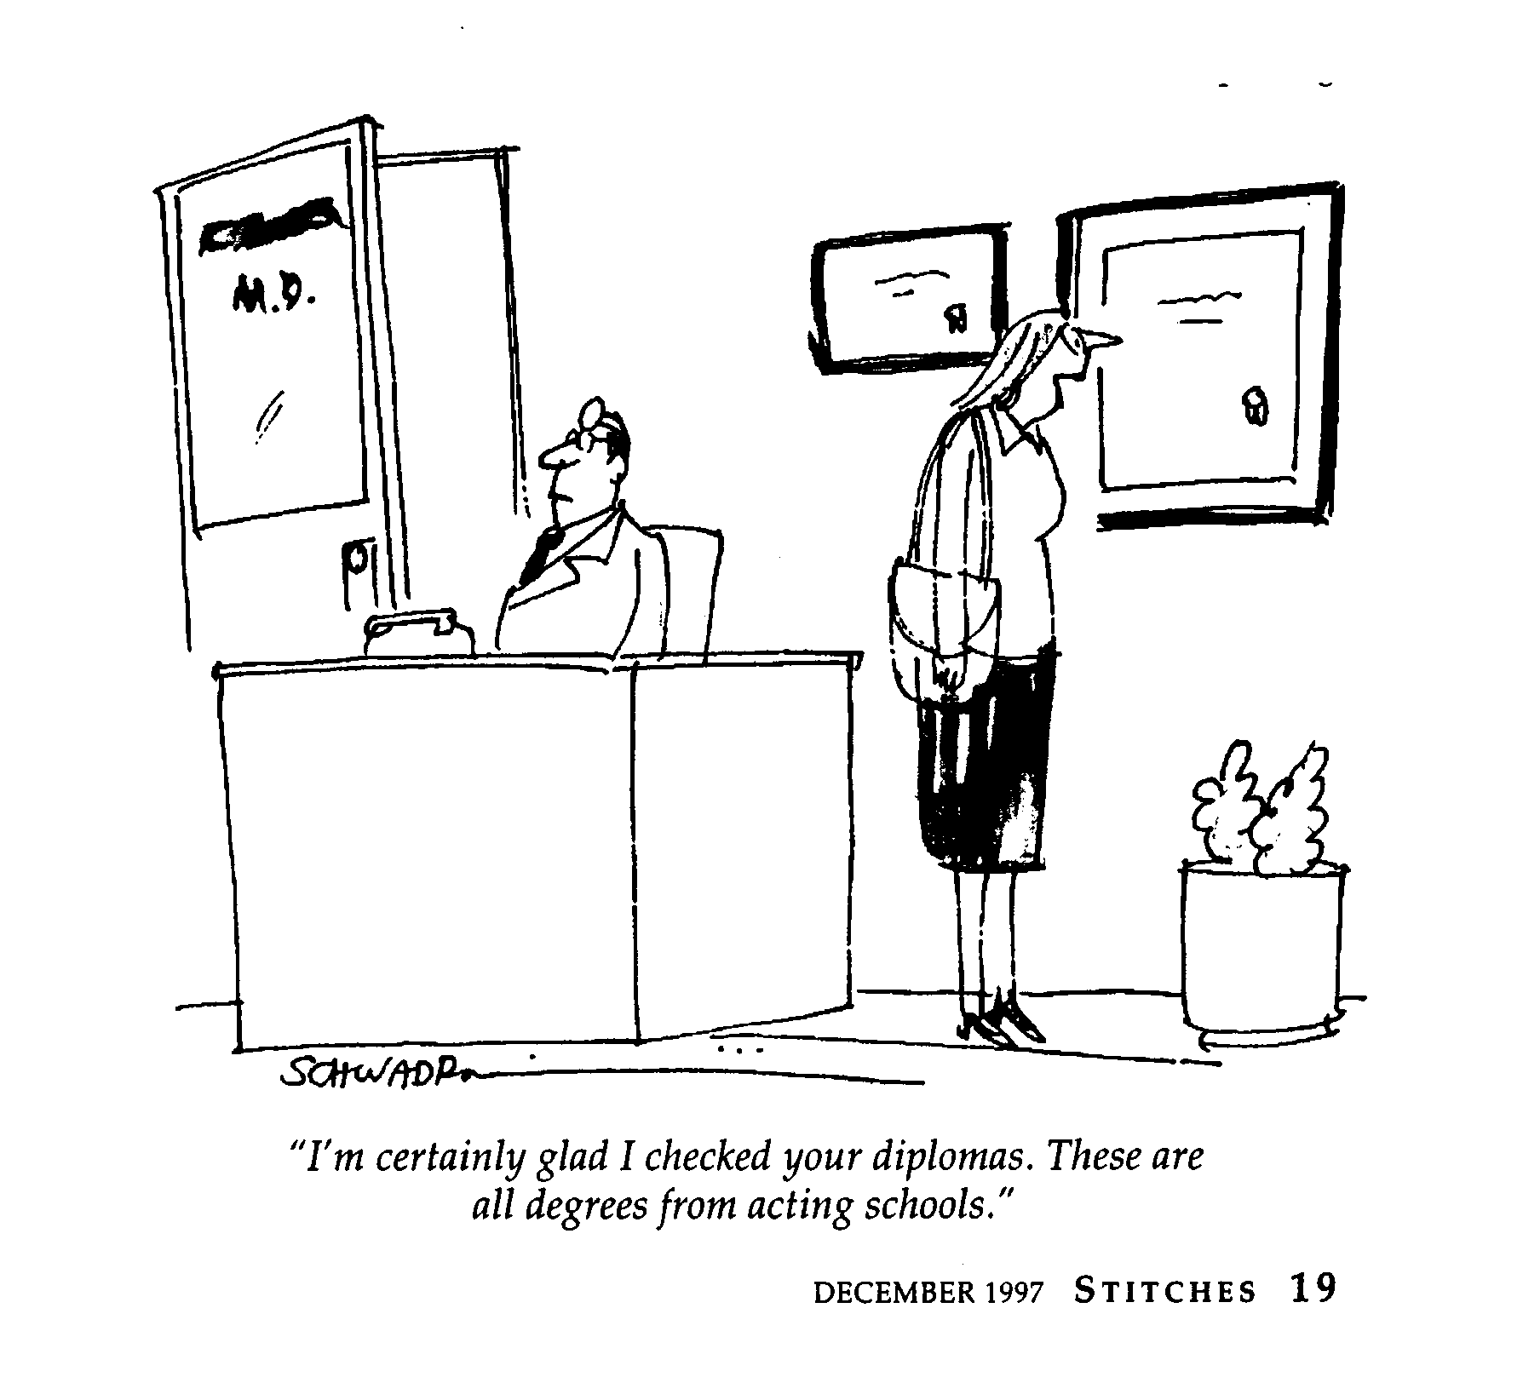

Slide 4
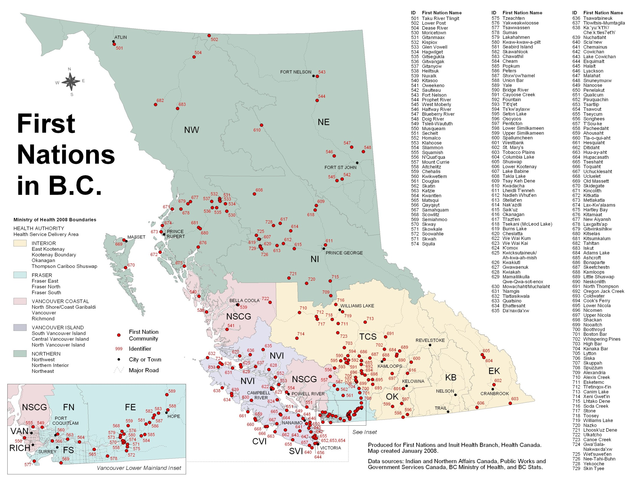
Notes:
Distances? Vancouver to Prince George? Vancouver to Fort Nelson. Note the Alaska panhandle.

Slide 5
About British Columbia
129,580 “NA Indian”
+ 59,445 Métis
+ 795 Inuit
4.8% of BC’s 4.3 million people
203 First Nations communities
BC has a land area of 95m hectares
The province is nearly 4X the size of Great Britain, 2.5X larger than Japan, & 1.35X bigger than Texas

Slide 6

Context
The New Relationship entered into between the Province of BC and the First Nations Leadership Council (all 203 chiefs of BC).
At the November 2005, First Ministers’ Meeting in Kelowna, the Transformative Change Accord (TCA) was signed by:
  First Nations Leadership Council,
  Premier of British Columbia, and
  Prime Minister of Canada
Key elements of this Accord: Housing & Infrastructure, Health, Education, and Economic Development
6

Slide 7
TCA:FNHP & TFNHP
Transformative Change Accord: First Nations Health Plan (TCA: FNHP) was signed between FN leaders and the Province in 2006
Tripartite First Nations Health Plan (TFNHP) added Federal Government as a signatory in 2007
There are now around 35 agreed-upon ‘action items’ grouped into two main categories:
  GOVERNANCE Actions (increased FN decision-making in health), &
  HEALTH ACTIONS (service & systems level change to improve health outcomes)

Slide 8
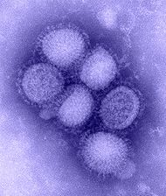
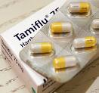
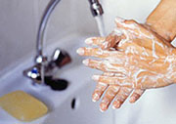
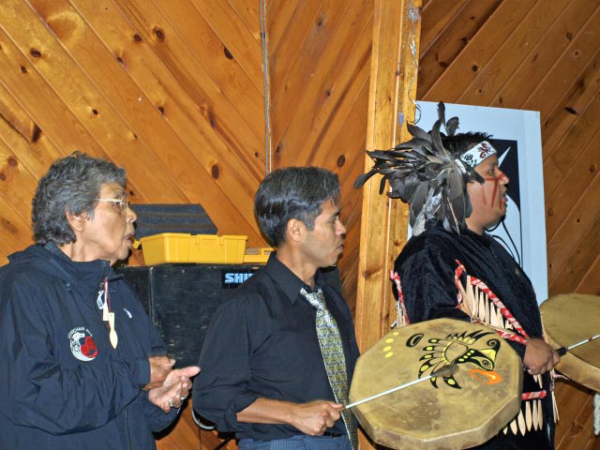
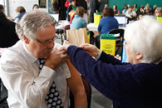
Novel H1N1
Influenza

Slide 9
Roles & Responsibilities for FN Health in the event of pandemic
Office of the Provincial Health Officer,
BC Ministry of Healthy Living & Sport
First Nations
Public Health
Agency of Canada
HEALTH CANADA -
First Nations & Inuit Health
Regional Health Authorities
Notes:
Although we are differing governmental bodies, we are interconnected through our Tripartite relationship.
The Roles and Responsibilities of First Nation Inuit Health, The Ministry of Healthy Living and Sport and the Regional Health Authority consist of the following:

Slide 10
First Nation Inuit Health –
Federal Government
Historically, Health Canada has been responsible for the provision of health services for First Nations & Inuit communities.
6

Slide 11
Ministry of Healthy Living & Sport – Provincial Government
Through the Office of the Provincial Health Officer (PHO) is the lead in the province in the event of a pandemic/communicable disease outbreak.
The PHO may rely heavily on the BC Centre of Disease Control (BCCDC) and his regional medical health officers (MHOs).
6

Slide 12
Regional Health Authorities
(“in the field”)
Health Authorities are responsible for planning the health system response to a pandemic influenza within their region
Liaise with their Medical Health Officers, the Provincial Health Officer, other Health Authorities, and Provincial counterparts.
Implement public health & infection control measures to reduce spread.
6

Slide 13
First Nations Communities – Local Planning
Developing, testing & regularly updating a community flu pandemic plan in collaboration with other stakeholders.
6

Slide 14
The BC FN H1N1 WG
2 First Nations chairs, both public health physicians
Physician reps from the BCCDC, the Public Health Agency of Canada, the Office of the PHO, and regional MHOs
First Nations Health Council rep
Physician from First Nations & Inuit Health, Health Canada
Met weekly

Slide 15
The BC FN H1N1 Action Plan
Clarification of lines of communication centred on MHOs
Point-of-care testing kits
Pre-placement of antivirals to remote communities
Mechanism to facilitate prescriptions in remote areas
Vaccination planning
Tripartite communications

Slide 16
Information for H1N1 Surveillance
Morbidity
  Influenza-like-illness (ILI) surveillance
  Visits to a nurse and/or doctor
  Influenza medications (over-the-counter or prescription)
  Hospitalizations
  Intensive care unit (ICU) admissions
Mortality
  Deaths due to H1N1
6
Notes:
Influenza-like illness activity already being monitored by on-reserve nurses!
ILI reported to MHOs
Cases tracked by BCCDC – though they had no way to track cases by ethnicity

Slide 17
Comparison with Other Indigenous Peoples Worldwide
H1N1 mortality rate was 4X higher in American Indians/Alaska Natives in Arizona and New Mexico
Maori and Pacific Islanders were 5 and 7X more likely respectively to require hospital admission for H1N1
http://ecdc.europa.eu/en/activities/sciadvice/Lists/ECDC%20Reviews/ECDC_DispForm.aspx?List=512ff74f%2D77d4%2D4ad8%2Db6d6%2Dbf0f23083f30&ID=696&Source=http%3A%2F%2Fstaging%2Eecdcdmz%2Eeuropa%2Eeu%2Fen%2Factivities%2Fsciadvice%2FLists%2FECDC%2520Reviews%2FAllIt
6

Slide 18
Comparison with Other Indigenous Peoples in Canada
In Canada Indigenous peoples are ~4% of the population but made up 17.6% of H1N1 hospital admissions
Inuit estimated to have 7X higher rate of H1N1 hospital admission and deaths
http://ecdc.europa.eu/en/activities/sciadvice/Lists/ECDC%20Reviews/ECDC_DispForm.aspx?List=512ff74f%2D77d4%2D4ad8%2Db6d6%2Dbf0f23083f30&ID=696&Source=http%3A%2F%2Fstaging%2Eecdcdmz%2Eeuropa%2Eeu%2Fen%2Factivities%2Fsciadvice%2FLists%2FECDC%2520Reviews%2FAllIt
6

Slide 19
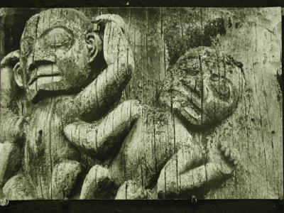
How did we do?

Slide 20
Evaluation High-level Findings - Successes
Good support for tripartite processes.
Increasing understanding of the need for cultural sensitivity.
Considerable community appreciation for the presence of First Nations physicians during the peak of the pandemic.
Nurses and other health service delivery staff from all three partners ‘make it work’ when they need to.

Slide 21
High-level Findings - Successes
Most felt that the pandemic planning process was helpful, although it did not close all of the gaps.
Relationships helped communications to work during the pandemic.
Most had the surveillance data they needed before and during the pandemic.
Participants are generally satisfied with vaccine anti-viral uptake, although there is less data to back up anti-viral uptake.

Slide 22
High-level Findings - Challenges
Working in a tripartite way is challenging with respect to communications.
Providing respectful support to First Nations communities does not always mean ‘telling them what to do’.
Community coordination was challenging – some communities didn’t know where their plans were, community contact lists were not up to date.
Not all of the Health Authorities were aware of the FN pandemic planning process.

Slide 23
High-level Findings - Challenges
Health Authorities need to work more closely with communities during the planning process.
Some stakeholders were not aware of their jurisdictional responsibilities.
PHAC policy direction was perceived to be slow, and somewhat vague, creating some inconsistencies in the provincial policy response.
Inconsistencies in the policy response created some culturally-sensitive issues (e.g., priority groups).

Slide 24
High-level Findings - Challenges
General feeling that had the outbreak been more severe we would have had significantly more difficulty.
  Policy challenges would have been greater.
Community planning needs to involve the right community members to work properly. It should also include health service delivery and the Health Authority.

Slide 25
Contact Information
Evan Adams, MD, MPH
Aboriginal Health Physician Advisor
Ministry of Healthy Living & Sport, &
First Nations Health Council
250-952-1349
or 604-913-2080, xt 284
evan.adams@gov.bc.ca
eadams@fnhc.ca

Slide 26
